Slide 1
Unit 3-2
Phase Changes

Slide 2
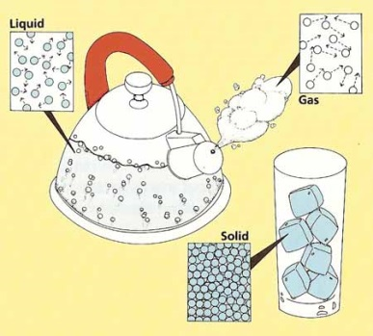
I. Phase Changes
A phase change is a physical change that occurs when one phase (state) of matter changes into another.
Usually occurs when thermal (heat) energy is added or removed

Slide 3
c. Thermal energy is determined by how much the molecules move.
i. In a solid the molecules move the slowest because they are closest together.
ii. In a gas the molecules move the fastest because they are furthest apart.
d. When we heat things up, molecules move faster which makes them spread apart. This gives them more energy.
i. Example: heating up a solid makes the molecules go from close together to spread out (solid to a liquid).
-(Think of melting butter in the microwave)

Slide 4
e. When we take away heat (cool things down), the molecules move slower which makes them move closer together. This gives them less energy.
i. Example- taking liquid water and freezing it. (liquid to a solid)

Slide 5
Animation: Solids, Liquids and Gases
Animation

Slide 6
II. Heating Curve
To show phase changes, a heating curve is used.
A heating curve is a graph of temperature against time.

Slide 7
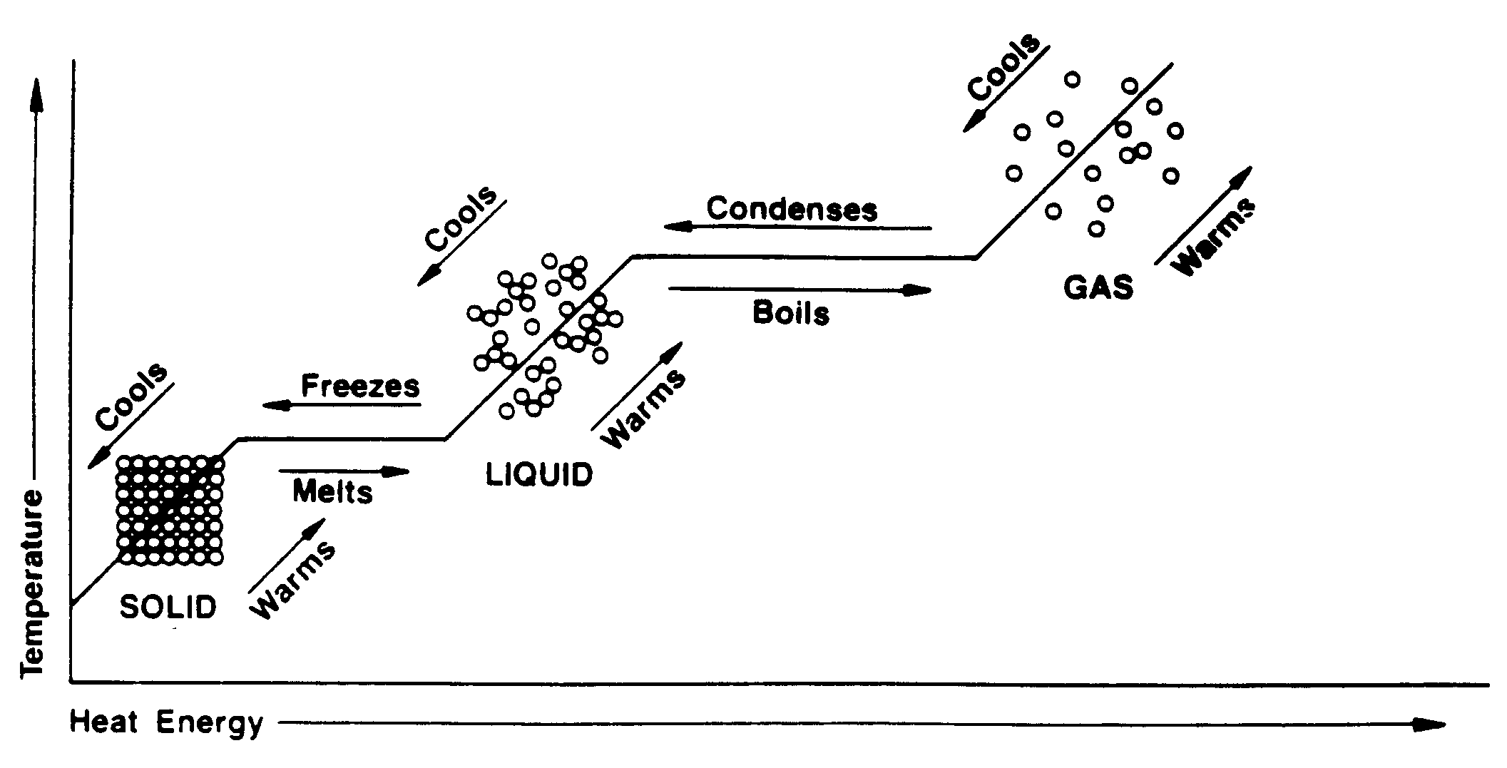

Slide 8
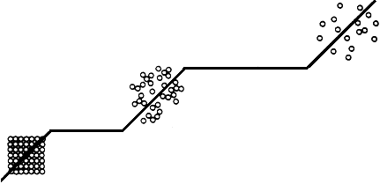
Y
F
D
E
TEMPERATURE (°C)
Gas
B
C
Liquid
A
Solid
X
HEAT ENERGY
Interactive Heating Curve
http://www.kentchemistry.com/links/Matter/HeatingCurve.htm

Slide 9
F
D
E
TEMPERATURE (°C)
B
C
A
HEAT ENERGY
Is the temperature changing from:
A B
Yes
D E
No
B C
No
E F
Yes
C D
Yes

Slide 10
F
D
E
TEMPERATURE (°C)
B
C
A
HEAT ENERGY
What is happening during the steps where the temperature is constant (not changing)?
PHASE CHANGES!

Slide 11
III. Melting
This occurs when a solid changes to a liquid.
Increase in temperature (addition of heat energy) causes particles to move faster and farther apart so the molecules spread out.

Slide 12
From left to right (absorbing energy)
Y
F
D
E
TEMPERATURE (°C)
Gas
MELTING
B
C
B
C
Liquid
A
Solid
HEAT ENERGY

Slide 13
IV. Freezing
A liquid changes to a solid.
Decrease in temperature (removal of heat energy) causes particles to move slower and closer together.

Slide 14
From right to left (losing energy)
Y
F
D
E
TEMPERATURE (°C)
Gas
Freezing
B
C
B
C
Liquid
A
Solid
HEAT ENERGY

Slide 15
V. Vaporization (Evaporation/Boiling)
A liquid changes to a gas
Increase in temperature (addition of heat energy) causes particles to move very fast and escape into the atmosphere.
There are 2 types-evaporation and boiling
i. Evaporation- only takes place on the surface of a liquid
-Example- puddle evaporating on a warm day
ii. Boiling- takes place on the surface and below the liquid.
-Example- boiling water

Slide 16
From left to right (absorbing energy)
Y
F
VAPORIZATION
E
D
E
D
TEMPERATURE (°C)
Gas
B
C
Liquid
A
Solid
HEAT ENERGY

Slide 17
From left to right (absorbing energy)
Y
F
VAPORIZATION
E
D
E
D
TEMPERATURE (°C)
Gas
MELTING
B
C
B
C
Liquid
A
Solid
HEAT ENERGY

Slide 18
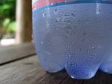
VI. Condensation
A gas changes to a liquid.
Decrease in temperature (removal of heat energy) causes particles to slow down to a point where they are in contact with one another.

Slide 19
From right to left (losing energy)
Y
F
Condensation
D
E
D
E
TEMPERATURE (°C)
Gas
B
C
Liquid
A
Solid
HEAT ENERGY

Slide 20
From right to left (losing energy)
Y
F
Condensation
D
E
D
E
TEMPERATURE (°C)
Gas
Freezing
B
C
B
C
Liquid
A
Solid
HEAT ENERGY

Slide 21
All together!

Slide 22
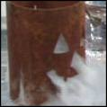
VII. Sublimation
Solid changes DIRECTLY to a gas (with NO liquid phase in between)
Examples:
Dry Ice (frozen Carbon Dioxide)
Iodine

Slide 23
VIII. Deposition
Gas changes DIRECTLY to a solid (with NO liquid phase in between)
Examples:
i. Snow-(air to ice)

Slide 24
VIII. Helpful Tip
Less dense to more dense = decrease temperature
i. Gas to a solid
More dense to less dense = increase temperature
i. Solid to a gas

Slide 25
Let’s Review!
Freezing
Condensation
Solid
Liquid
Gas
Melting
Vaporization

Slide 26
Deposition
Solid
Liquid
Gas
Sublimation

Slide 27
VIII. Important Temperatures
a. Melting Point – the temperature at which any more additional heat will cause a solid to melt.
Water (ice cube) 0° Celsius
Gold 1064 ° Celsius
Oxygen -218 ° Celsius
http://www.mathsisfun.com/temperature-conversion.html
Conversion from Celsius to Fahrenheit

Slide 28
b. Freezing Point – the temperature at which more heat removal will cause a liquid to change to a solid.
Water 0° Celsius
Gold 1064° Celsius

Slide 29
c. Boiling Point – the temperature at which any additional heat will cause a liquid to change to a gas.
Water 100° Celsius (212 F °)
Gold 2807°Celsius
Nitrogen -196°Celsius
Oxygen - 183°Celsius

Slide 30
If this diagram is for water (H₂0)…
Y
F
D
E
TEMPERATURE (°C)
Gas
B
C
Liquid
A
Solid
HEAT ENERGY
0°C
100°C

Slide 31
Some general thoughts….
As you move from left to right, the heat energy increases over time.
Instead of raising the temperature, the heat energy is used to provide the molecules with more energy to move around.
As you move from right to left, the heat energy decreases (is lost to the environment, or atmosphere) over time.
Instead, the heat energy is lost because the molecules are becoming more rigid, and they do not need the extra energy for particles to move around

Slide 32
Activities
Matter Activities

